Slide 1
Online pedestrian tracking with multi-stage re-identification
Yi-Fan Jiang, Hyunhak Shin, Jaeyong Ju, Hanseok Ko
School of Electrical Engineering, Korea University,
Seoul, South Korea

Slide 2
Table of Contents
Introduction
Proposed method
Contribution
Overview
Data association stage
Two re-identification stages
Experimental results
Conclusion & Future work

Slide 3
1. Introduction

Slide 4
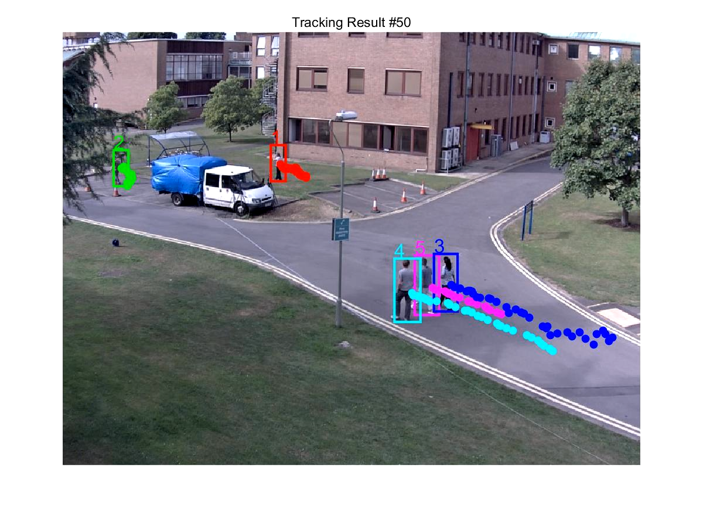
What is Multi-Person Tracking?
Multi-Person tracking (MPT) is to find the locations and sizes of multiple persons and conserve their identities (IDs) in image sequences.
ID
Location
(x, y)
Size
(width, height)

Slide 5
Tracking-by-Detection Strategy
Categorization: Offline (Batch) vs. Online (Sequential)
Offline processing
Tracking at time t
…
…
available information
Online processing
Tracking at time t
…
…
available information
future information

Slide 6
Tracking-by-Detection Strategy
Categorization: Offline (Batch) vs. Online (Sequential)
Offline : It builds multiple trajectories by globally optimizing detections within the entire video or a large sliding window [1, 2, 3].
Online : It sequentially builds object trajectories based on frame-by-frame data association [4, 5, 6].
This research follows an online tracking-by-detection strategy which can be applied to online applications.
 | Accuracy / Robustness | Computational cost / Latency
Offline | High | Large
Online | Low | Small
<Summary of pros and cons>

Slide 7
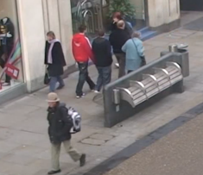
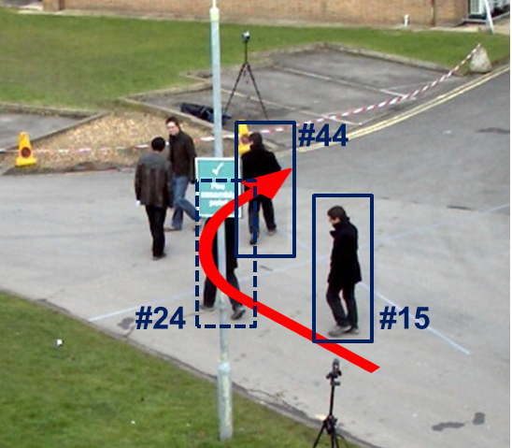
Challenges
Solving the MPT problem with tracking-by-detection framework in complex scenes is still challenging due to various issues.
1. Frequent and prolonged occlusions
2. Abrupt motion change
An occlusion with abrupt motion change situation
(#24,…, #40)
occlusion between objects
occlusion by background objects
<Occlusions>
<Abrupt motion change>

Slide 8
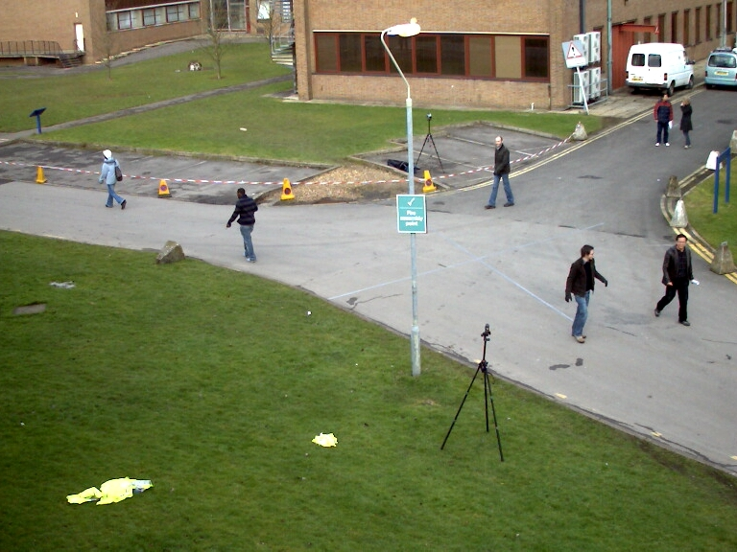
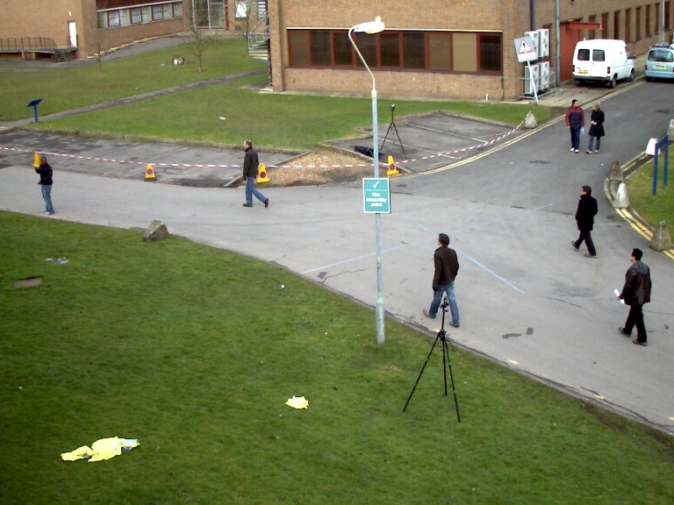
Challenges
Solving the MPT problem with tracking-by-detection framework in complex scenes is still challenging due to various issues.
3. Re-enter targets
New person? (x)
or
Existing person? (o)
exit
re-enter
<Re-enter targets>

Slide 9
2. Proposed method

Slide 10
Contribution
Our proposed method is an enhancement of the approach of Ju et al. [7], which focuses on dealing with track drift and re-identification in cases of target re-entry.
We handle track drift problem under long-term occlusion with associating between re-appearance detections and lost targets contained in past frames, through the use of a target appearance model and target size information.
To handle re-enter problem, we associate re-appearance detections with targets who had exited the FOV, and this association is determined according to a target appearance model.

Slide 11
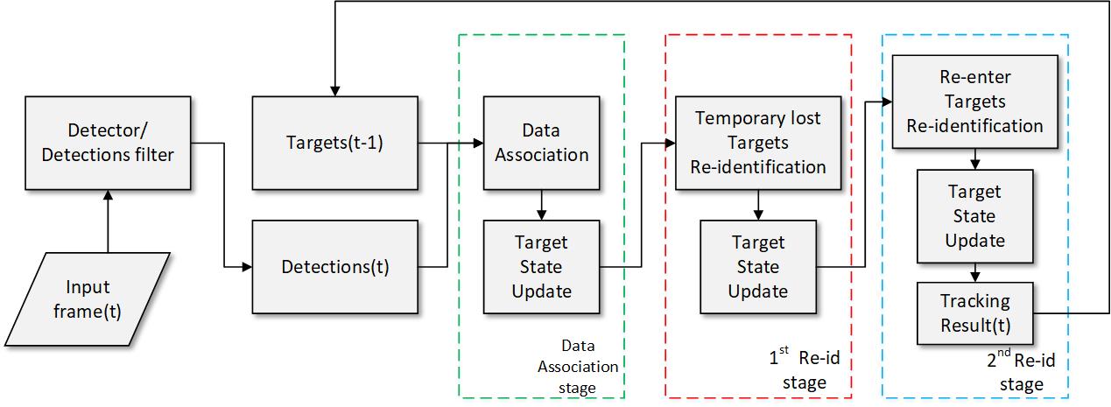
Overview
Data association stage
First re-identification stage
Second re-identification stage

Slide 12
Overview
Goal
Estimating target location with data association and multi-stage re-identification between previous tracks and current detections.
Estimating target location by data association with appearance, size and position affinity.
Solving track drifting problem under long-term occlusion by 1st re-identification stage with appearance and size affinity.
Solving target re-enter problem by 2nd re-identification stage with appearance affinity.

Slide 13
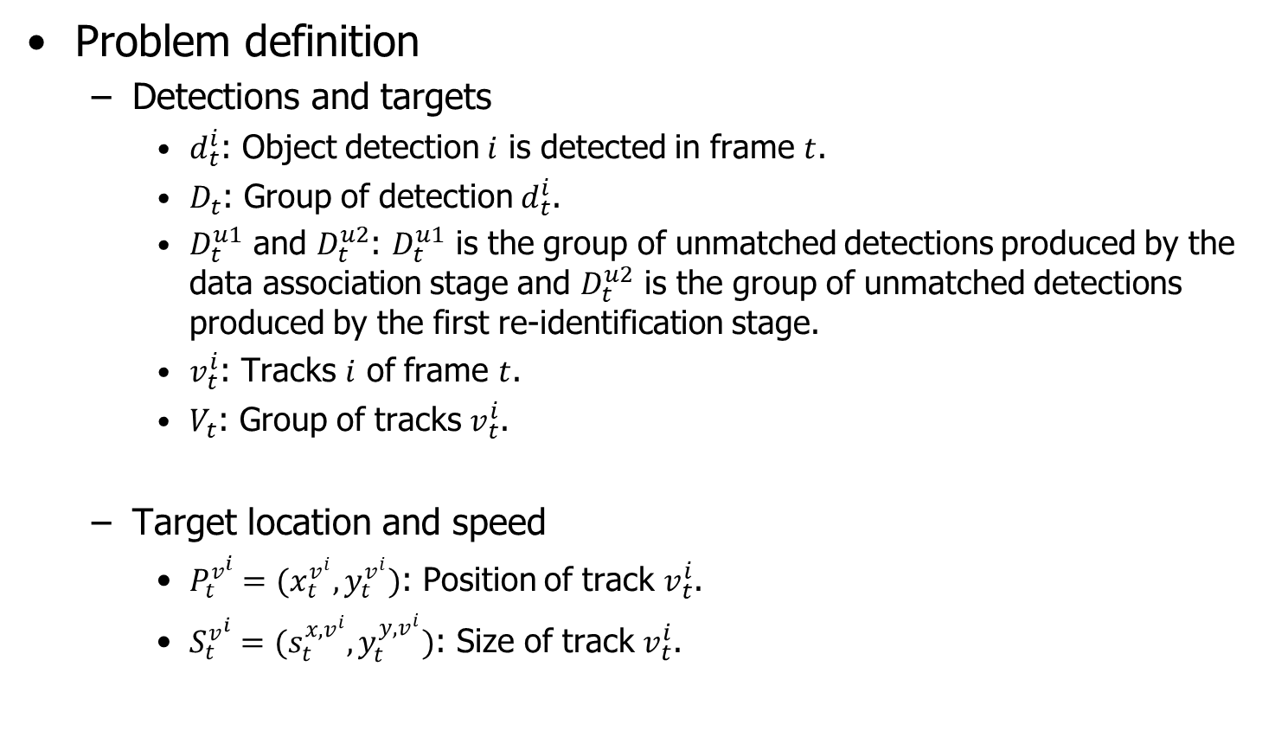
Overview
Problem definition
Detections and targets
$d_{t}^{i}$: Object detection $i$ is detected in frame $t$.
$D_{t}$: Group of detection $d_{t}^{i}$.
$D_{t}^{u1}$ and $D_{t}^{u2}$: $D_{t}^{u1}$ is the group of unmatched detections produced by the data association stage and $D_{t}^{u2}$ is the group of unmatched detections produced by the first re-identification stage.
$v_{t}^{i}$: Tracks $i$ of frame $t$.
$V_{t}$: Group of tracks $v_{t}^{i}$.
Target location and speed
$P_{t}^{v^{i}}=(x_{t}^{v^{i}},y_{t}^{v^{i}})$: Position of track $v_{t}^{i}$.
$S_{t}^{v^{i}}=(s_{t}^{{x,v}^{i}},y_{t}^{{y,v}^{i}})$: Size of track $v_{t}^{i}$.

Slide 14
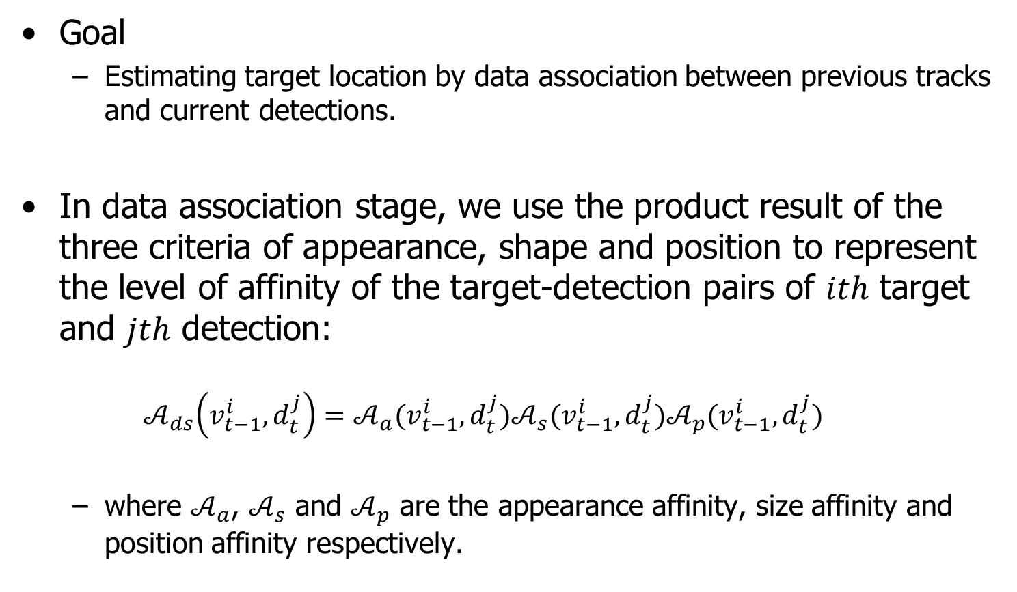
Data association stage
Goal
Estimating target location by data association between previous tracks and current detections.
In data association stage, we use the product result of the three criteria of appearance, shape and position to represent the level of affinity of the target-detection pairs of $ith$ target and $jth$ detection:
$$𝒜_{ds}\left(v_{t−1}^{i},d_{t}^{j}\right)=𝒜_{a}(v_{t−1}^{i},d_{t}^{j})𝒜_{s}(v_{t−1}^{i},d_{t}^{j})𝒜_{p}(v_{t−1}^{i},d_{t}^{j})$$
where $𝒜_{a}$, $𝒜_{s}$ and $𝒜_{p}$ are the appearance affinity, size affinity and position affinity respectively.

Slide 15
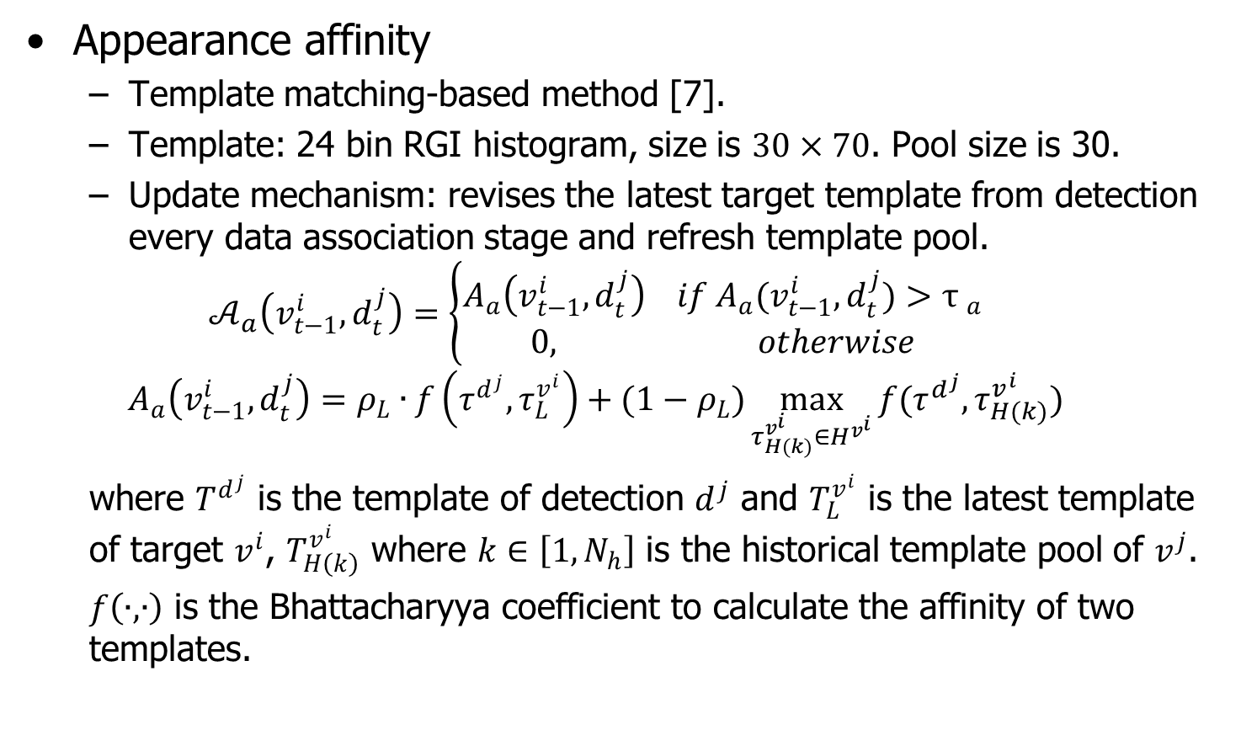
Data association stage
Appearance affinity
Template matching-based method [7].
Template: 24 bin RGI histogram, size is $30×70$. Pool size is 30.
Update mechanism: revises the latest target template from detection every data association stage and refresh template pool.
$$𝒜_{a}\left(v_{t−1}^{i},d_{t}^{j}\right)=\left\{\begin{aligned}A_{a}\left(v_{t−1}^{i},d_{t}^{j}\right) if A_{a}(v_{t−1}^{i},d_{t}^{j})>{τ }_{a} \\ 0, otherwise\end{aligned}\right.$$
$$A_{a}\left(v_{t−1}^{i},d_{t}^{j}\right)=ρ_{L}∙f\left(τ^{d^{j}},τ_{L}^{v^{i}}\right)+(1−ρ_{L})\max_{τ_{H(k)}^{v^{i}}∈H^{v^{i}}}{f(τ^{d^{j}},τ_{H(k)}^{v^{i}})}$$
where $T^{d^{j}}$ is the template of detection $d^{j}$ and $T_{L}^{v^{i}}$ is the latest template of target $v^{i}$, $T_{H\left(k\right)}^{v^{i}}$ where $k∈\left[1,N_{h}\right]$ is the historical template pool of $v^{j}$.
$f\left(∙,∙\right)$ is the Bhattacharyya coefficient to calculate the affinity of two templates.

Slide 16
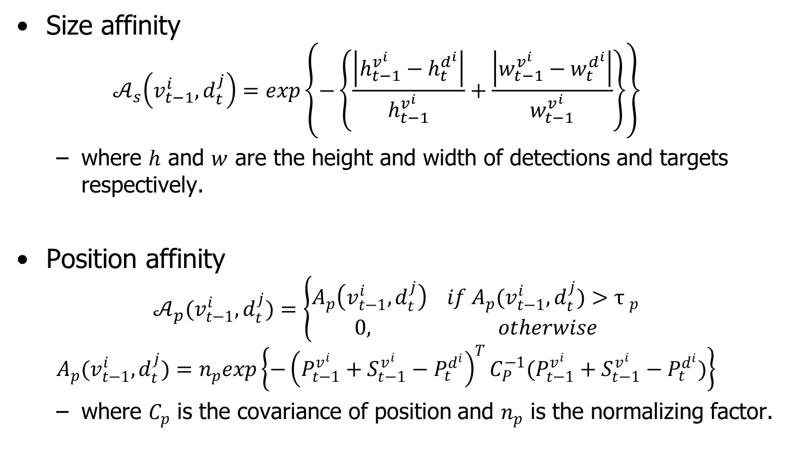
Data association stage
Size affinity
$$𝒜_{s}\left(v_{t−1}^{i},d_{t}^{j}\right)=exp\left\{−\left\{\frac{\left|h_{t−1}^{v^{i}}−h_{t}^{d^{i}}\right|}{h_{t−1}^{v^{i}}}+\frac{\left|w_{t−1}^{v^{i}}−w_{t}^{d^{i}}\right|}{w_{t−1}^{v^{i}}}\right\}\right\}$$
where $h$ and $w$ are the height and width of detections and targets respectively.
Position affinity
$$𝒜_{p}(v_{t−1}^{i},d_{t}^{j})=\left\{\begin{aligned}A_{p}\left(v_{t−1}^{i},d_{t}^{j}\right) if A_{p}(v_{t−1}^{i},d_{t}^{j})>{τ }_{p} \\ 0, otherwise\end{aligned}\right.$$
$$A_{p}(v_{t−1}^{i},d_{t}^{j})=n_{p}exp\left\{−{\left(P_{t−1}^{v^{i}}+S_{t−1}^{v^{i}}−P_{t}^{d^{i}}\right)}^{T}C_{P}^{−1}(P_{t−1}^{v^{i}}+S_{t−1}^{v^{i}}−P_{t}^{d^{i}})\right\}$$
where $C_{p}$ is the covariance of position and $n_{p}$ is the normalizing factor.

Slide 17
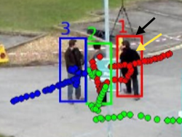
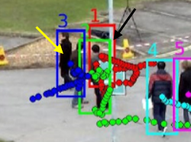
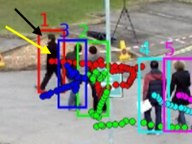
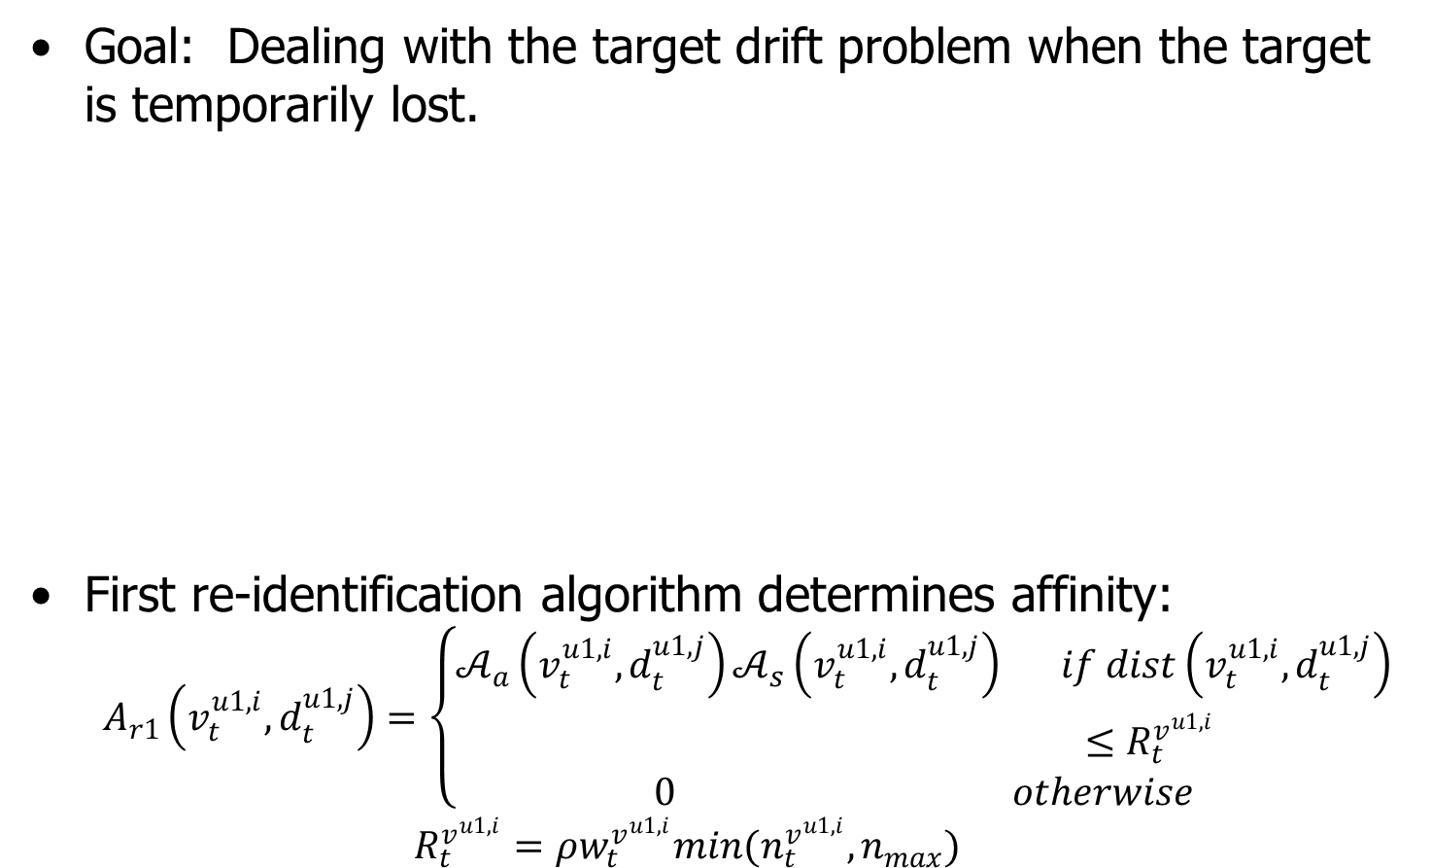
First re-identification stage
Goal: Dealing with the target drift problem when the target is temporarily lost.
First re-identification algorithm determines affinity:
$$A_{r1}\left(v_{t}^{u1,i},d_{t}^{u1,j}\right)=\left\{\begin{aligned}𝒜_{a}\left(v_{t}^{u1,i},d_{t}^{u1,j}\right)𝒜_{s}\left(v_{t}^{u1,i},d_{t}^{u1,j}\right) if dist\left(v_{t}^{u1,i},d_{t}^{u1,j}\right) \\ ≤R_{t}^{v^{u1,i}} \\ 0 otherwise\end{aligned}\right.$$
$$R_{t}^{v^{u1,i}}=ρw_{t}^{v^{u1,i}}min(n_{t}^{v^{u1,i}},n_{max})$$
<Normally tracking >
<Temporary lost >
<Recovery from temporary lost >

Slide 18
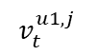

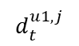
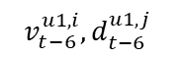
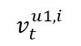



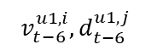
First re-identification stage
First re-id details:
t$frame → (t + 2) frame$
$$d_{t+2}^{u1,i}$$
$$v_{t+2}^{u1,i}$$
$$d_{t}^{u1,j}$$
$$v_{t}^{u1,j}$$
$$v_{t}^{u1,i}$$
$$R_{t−2}^{v^{u1,i}}$$
$$v_{t−6}^{u1,i},d_{t−6}^{u1,j}$$
$$v_{t−6}^{u1,i},d_{t−6}^{u1,j}$$
$$R_{t}^{v^{u1,i}}$$
Associated track
Associated detection
Detection response
Un-associated track
Lower uncertainty
Temporary lost target
Corrected track

Slide 19
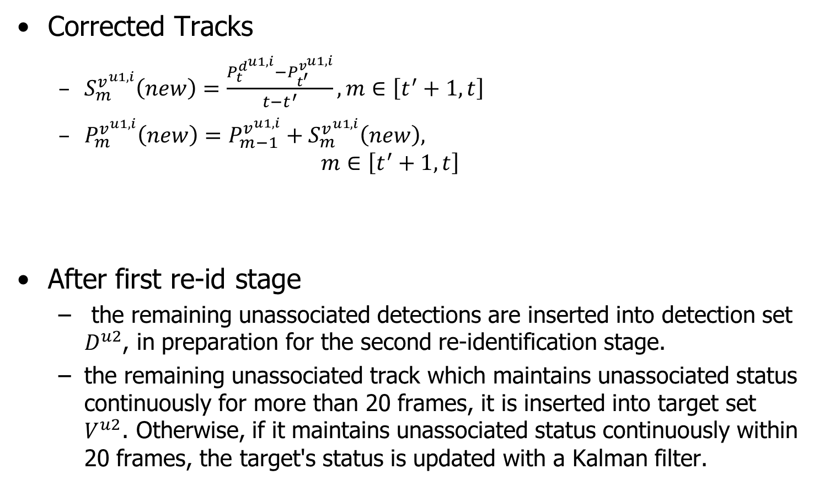

First re-identification stage
$$v_{t+2}^{u1,i}$$
Corrected Tracks
$S_{m}^{v^{u1,i}}\left(new\right)=\frac{P_{t}^{d^{u1,i}}−P_{t^{′}}^{v^{u1,i}}}{t−t^{′}}, m∈\left[t^{′}+1,t\right]$
$P_{m}^{v^{u1,i}}\left(new\right)=P_{m−1}^{v^{u1,i}}+S_{m}^{v^{u1,i}}\left(new\right),$
$$m∈\left[t^{′}+1,t\right]$$
After first re-id stage
the remaining unassociated detections are inserted into detection set $D^{u2}$, in preparation for the second re-identification stage.
the remaining unassociated track which maintains unassociated status continuously for more than 20 frames, it is inserted into target set $V^{u2}$. Otherwise, if it maintains unassociated status continuously within 20 frames, the target's status is updated with a Kalman filter.
$$v_{t}^{u1,j}$$
$$v_{t−6}^{u1,i},d_{t−6}^{u1,j}$$

Slide 20
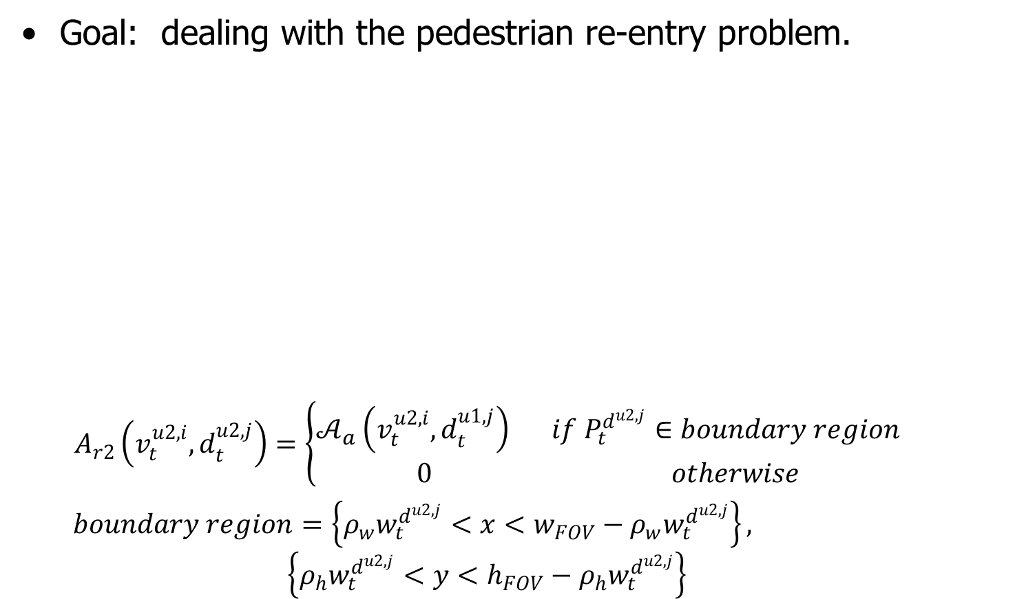
Second re-identification stage
Goal: dealing with the pedestrian re-entry problem.
$$A_{r2}\left(v_{t}^{u2,i},d_{t}^{u2,j}\right)=\left\{\begin{aligned}𝒜_{a}\left(v_{t}^{u2,i},d_{t}^{u1,j}\right) if P_{t}^{d^{u2,j}}∈boundary region \\ 0 otherwise\end{aligned}\right.$$
$boundary region$ $=\left\{ρ_{w}w_{t}^{d^{u2,j}}<x<w_{FOV}−ρ_{w}w_{t}^{d^{u2,j}}\right\},$
$$\left\{ρ_{h}w_{t}^{d^{u2,j}}<y<h_{FOV}−ρ_{h}w_{t}^{d^{u2,j}}\right\}$$
New person? (x)
or
Existing person? (o)
exit
re-enter

Slide 21
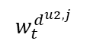
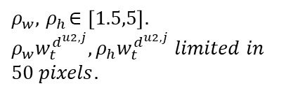
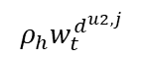
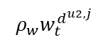
Second re-identification stage
Dynamic boundary region
$$ρ_{w}w_{t}^{d^{u2,j}}$$
$$ρ_{h}w_{t}^{d^{u2,j}}$$
$$w_{t}^{d^{u2,j}}$$
$ρ_{w},{ ρ}_{h}∈\left[1.5,5\right].$
$$ρ_{w}w_{t}^{d^{u2,j}},ρ_{h}w_{t}^{d^{u2,j}} limited in 50 pixels.$$

Slide 22
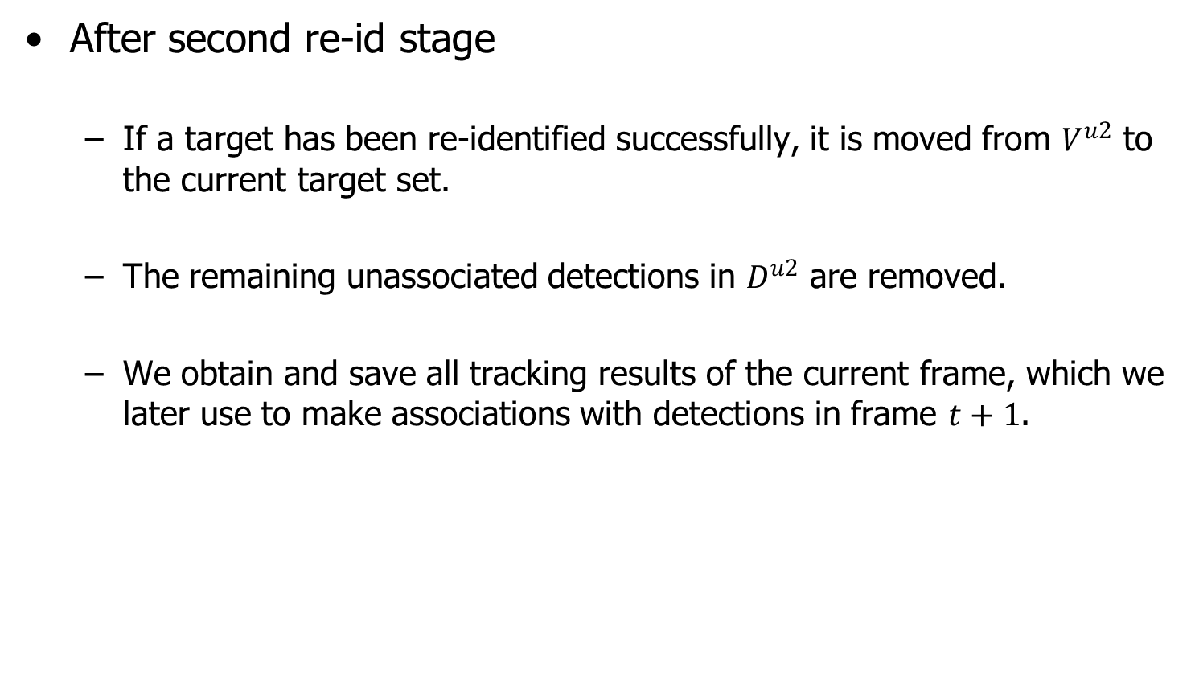
Second re-identification stage
After second re-id stage
If a target has been re-identified successfully, it is moved from $V^{u2}$ to the current target set.
The remaining unassociated detections in $D^{u2}$ are removed.
We obtain and save all tracking results of the current frame, which we later use to make associations with detections in frame $t+1$.

Slide 23
3. Experimental results

Slide 24
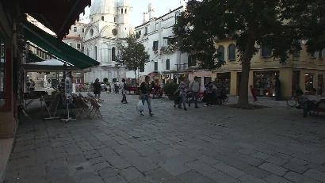
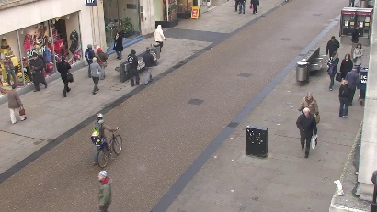
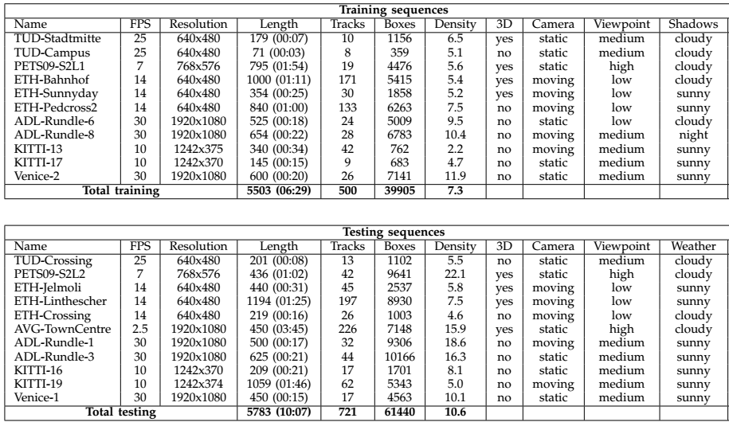


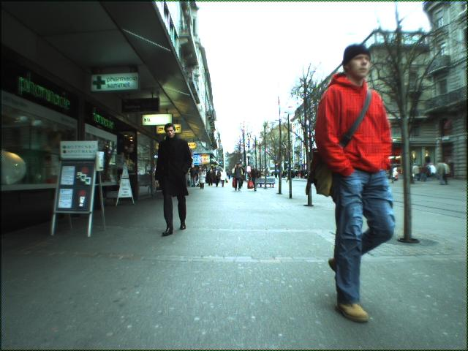
Datasets
Multiple Object Tracking Challenge (MOTC) [8]
Total 22 sequences (Training = 11 / Testing = 11)
Each sequence has different characteristics
frame rate, pedestrian density, illumination, point of view
Venice-1
Town-Centre
KITTI-16
ADL-Rundle-3
ETH-Bahnhof

Slide 25
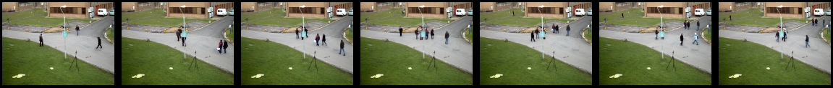
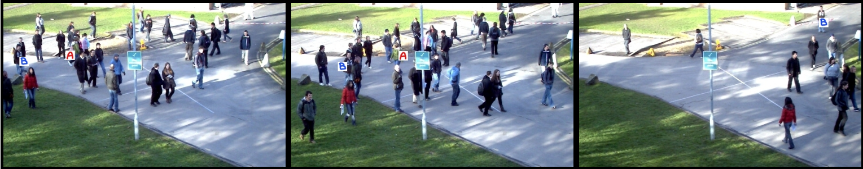
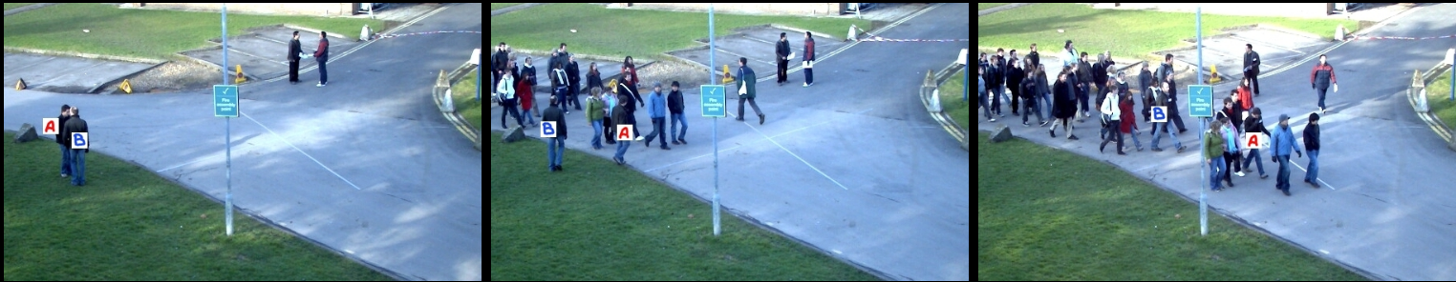
Datasets
PETS 2009 [9]
Same location but has different camera view points;
Each sequence has different characteristics
Different usage: Person count, density estimation, people tracking, flow analysis and event recognition.
Pedestrian density: Dense, medium and sparse crowd.
Illumination: Bright sunshine, shadows, overcast.
Dataset S2: People Tracking
Scenario: S2.L1 walking
Scenario: S2.L2 walking
Scenario: S2.L3 walking

Slide 26
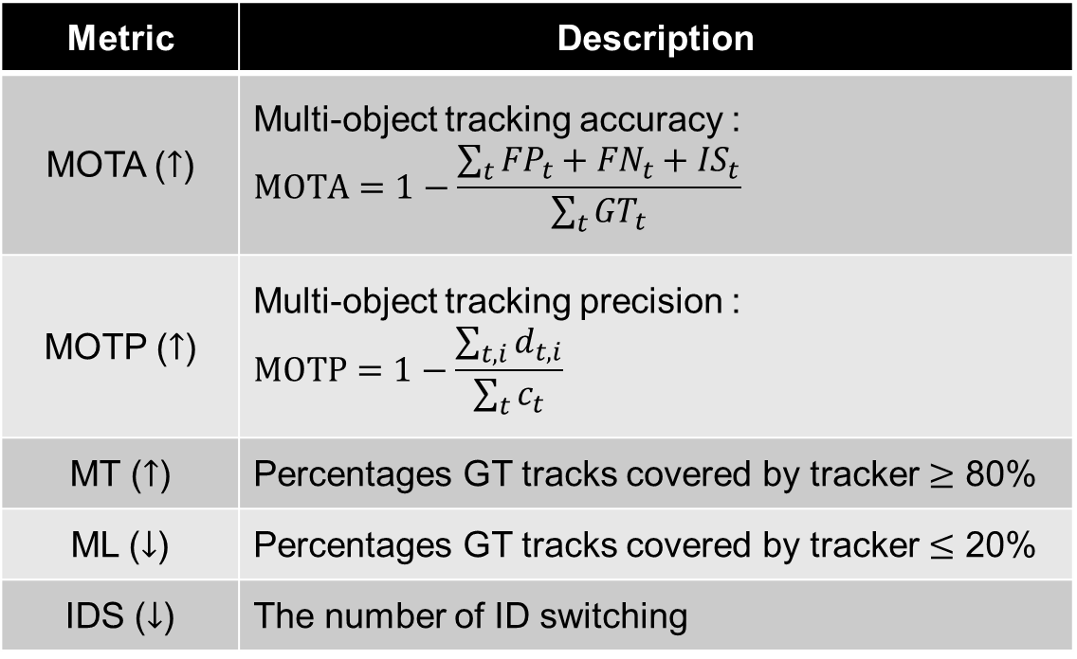
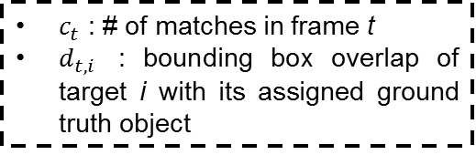
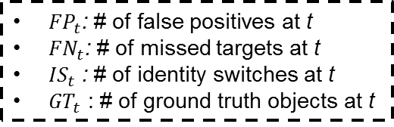
Evaluation metrics
Performance evaluation for multi-target tracking
Metric | Description
MOTA ($↑$) | Multi-object tracking accuracy : $$MOTA=1−\frac{\sum_{t}{{FP}_{t}+{FN}_{t}+{IS}_{t}}}{\sum_{t}{{GT}_{t}}}$$
MOTP ($↑$) | Multi-object tracking precision : $$MOTP=1−\frac{\sum_{t,i}{d_{t,i}}}{\sum_{t}{c_{t}}}$$
MT ($↑$) | Percentages GT tracks covered by tracker $≥$ 80%
ML ($↓$) | Percentages GT tracks covered by tracker $≤$ 20%
IDS ($↓$) | The number of ID switching
${FP}_{t}$: # of false positives at t
${FN}_{t}$: # of missed targets at t
${IS}_{t}$ : # of identity switches at t
${GT}_{t}$ : # of ground truth objects at t
$c_{t}$ : # of matches in frame t
$d_{t,i}$ : bounding box overlap of target i with its assigned ground truth object

Slide 27
Tracking performance comparison
Performance comparison of our proposed method
Dataset (Sequence) | Method | MOTP (%) | MOTA (%) | MT(%) | ML (%) | IDS
PETS(S2L1) | Proposed | 75.8 | 91.0 | 95.1 | 0 | 5
 | Ju et al. [7] | 75.3 | 90.4 | 94.7 | 0 | 11
 | Milan et al. [10] | 76.1 | 87.4 | 100 | 0 | 31
 | Milan et al. [11] | 74.3 | 90.3 | 100 | 0 | 26
 | Zamir et al. [12] | 69.0 | 90.3 | - | - | 11
PETS(S2L2) | Proposed | 73.3 | 56.4 | 48.9 | 0 | 197
 | Ju et al. [7] | 71.8 | 56.8 | 39.6 | 0 | 230
 | Solera et al. [13] | 70.8 | 47.4 | 14.0 | 7.0 | 297
 | Pirsiavash et al. [14] | 64.1 | 45.0 | 39.5 | 16.3 | 201
MOT (Town-Centre) | Proposed | 74.7 | 66.4 | 55.4 | 1.8 | 255
 | Ju et al. [7] | 74.7 | 66.3 | 56.1 | 8.7 | 260
 | Sanchez-Matilla et al. [15] | 68.5 | 17.3 | 4.9 | 49.1 | 201
 | Dicle et al. [16] | 70.0 | 15.0 | 2.2 | 58.4 | 76

Slide 28
4. Conclusion & Future work

Slide 29
Conclusion & Future work
Conclusion
We have described an online pedestrian tracking framework based on multi-stage re-identification in order to deal with two common tracking problems:
the track drift problem caused by target motion abruptly changing during a long period of occlusion;
the target re-identification problem caused by the target leaving the FOV but re-appearing later.
Future work
We consider the future work focusing on reducing the dependency on detection quality to improve the system performance when handle high density crowd sequences.

Slide 30
Reference
[1] A. Milan, S. Roth, and K. Schindler. Continuous energy minimization for multitarget tracking. IEEE transactions on pattern analysis and machine intelligence, 36(1):58–72, 2014.
[2] W. Brendel, M. Amer, and S. Todorovic. Multiobject tracking as maximum weight independent set. In Computer Vision and Pattern Recognition (CVPR), 2011 IEEE Conference on, pages 1273–1280. IEEE, 2011.
[3] B. Yang and R. Nevatia. Multi-target tracking by online learning of non-linear motion patterns and robust appearance models. In Computer Vision and Pattern Recognition (CVPR), 2012 IEEE Conference on, pages 1918–1925. IEEE, 2012.
[4] M. D. Breitenstein, F. Reichlin, B. Leibe, E. Koller-Meier, and L. Van Gool. Online multiperson tracking-by-detection from a single, uncalibrated camera. IEEE transactions on pattern analysis and machine intelligence, 33(9):1820–1833, 2011.
[5] X. Song, J. Cui, H. Zha, and H. Zhao. Vision-based multiple interacting targets tracking via on-line supervised learning. In European Conference on Computer Vision, pages 642–655. Springer, 2008.
[6] J. H. Yoon, M.-H. Yang, J. Lim, and K.-J. Yoon. Bayesian multi-object tracking using motion context from multiple objects. In Applications of Computer Vision (WACV), 2015 IEEE Winter Conference on, pages 33–40. IEEE, 2015.
[7] J. Ju, D. Kim, B. Ku, D. K. Han, and H. Ko. Online multiobject tracking based on hierarchical association framework. In Proceedings ofthe IEEE Conference on Computer Vision and Pattern Recognition Workshops, pages 34–42, 2016.
[8] 2D MOT 2015 Dataset. https://motchallenge. net/data/2D_MOT_2015/.
[9] PETS 2009 Benchmark Data. http://www.cvg.reading.ac.uk/PETS2009/a.html.
[10] A. Milan, K. Schindler, and S. Roth. Multi-target tracking by discrete-continuous energy minimization. IEEE transactions on pattern analysis and machine intelligence, 38(10):2054–2068, 2016.
[11] A. Milan, K. Schindler, and S. Roth. Detection-and trajectory-level exclusion in multiple object tracking. In Proceedings of the IEEE Conference on Computer Vision and Pattern Recognition, pages 3682–3689, 2013.
[12] A. Roshan Zamir, A. Dehghan, and M. Shah. Gmcp-tracker: Global multi-object tracking using generalized minimum clique graphs. Computer Vision–ECCV 2012, pages 343–356, 2012.
[13] F. Solera, S. Calderara, and R. Cucchiara. Learning to divide and conquer for online multi-target tracking. In Proceedings of the IEEE International Conference on Computer Vision, pages 4373–4381, 2015.
[14] H. Pirsiavash, D. Ramanan, and C. C. Fowlkes. Globallyoptimal greedy algorithms for tracking a variable number of objects. In Computer Vision and Pattern Recognition (CVPR), 2011 IEEE Conference on, pages 1201–1208. IEEE, 2011.
[15] R. Sanchez-Matilla, F. Poiesi, and A. Cavallaro. Online multi-target tracking with strong and weak detections. In European Conference on Computer Vision, pages 84–99. Springer, 2016.
[16] C. Dicle, O. I. Camps, and M. Sznaier. The way they move: Tracking multiple targets with similar appearance. In Proceedings ofthe IEEE International Conference on Computer Vision, pages 2304–2311, 2013.

Slide 31
Thank you!

